Slide 1


Green Hoa Lac Capstone project presentation

Slide 2

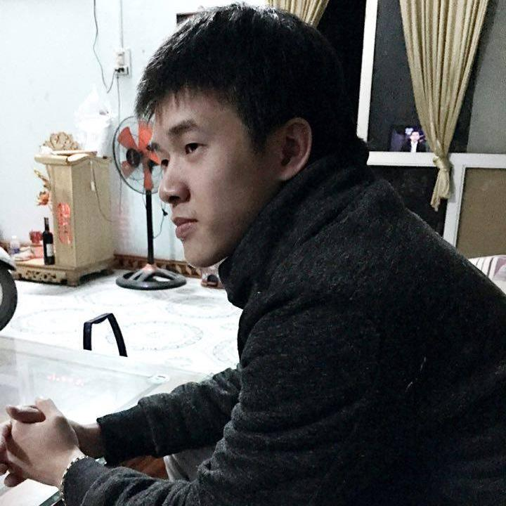
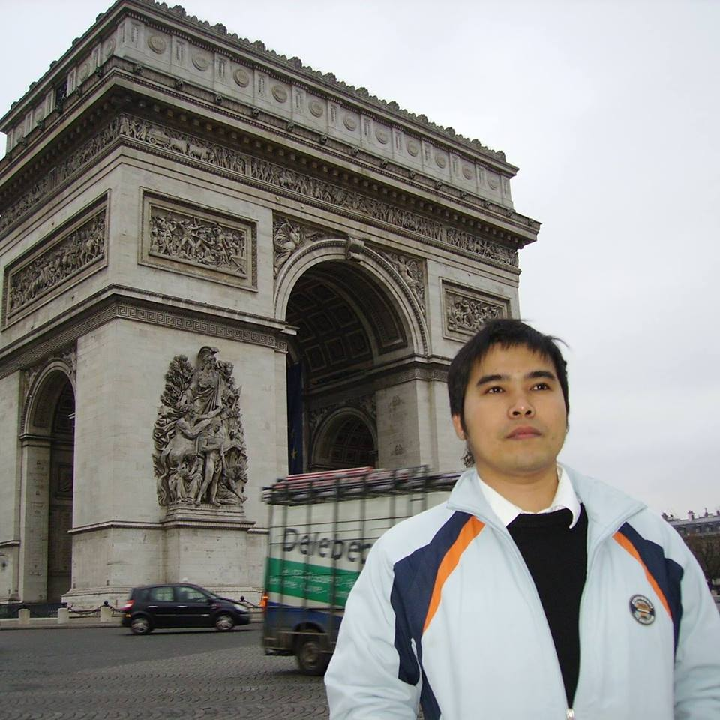




Supervisor
Technical Leader
QA Leader
PhD. Phan Duy Hung
Mr.
Le Anh Tuyen
Ms. Nguyen Thi Ly Linh
Team Leader
Test Leader
Mr. Pham Quang Khang
Mr. Ho Quang Hao
Our Amazing Team
Team Member
Team Member
Mr. Lam Duc Thang
Mr. Bui Manh Tri
Teamwork makes the dream work!

Slide 3


TABLE OF CONTENT
01.
PROJECT OVERVIEW
02.
PROJECT
MANAGEMENT
08.
DEMO
03.
REQUIREMENTS
SPECIFICATION
07.
LESSION LEARNED
04. SYSTEMS
DESIGN
06.
TESTING
05.
IMPLEMENT

Slide 4




I. PROJECT OVERVIEW
CORE IDEA
EXISTING COMPETITORS
ADVANTAGES
WHY ANDROID MOBILE?

Slide 5

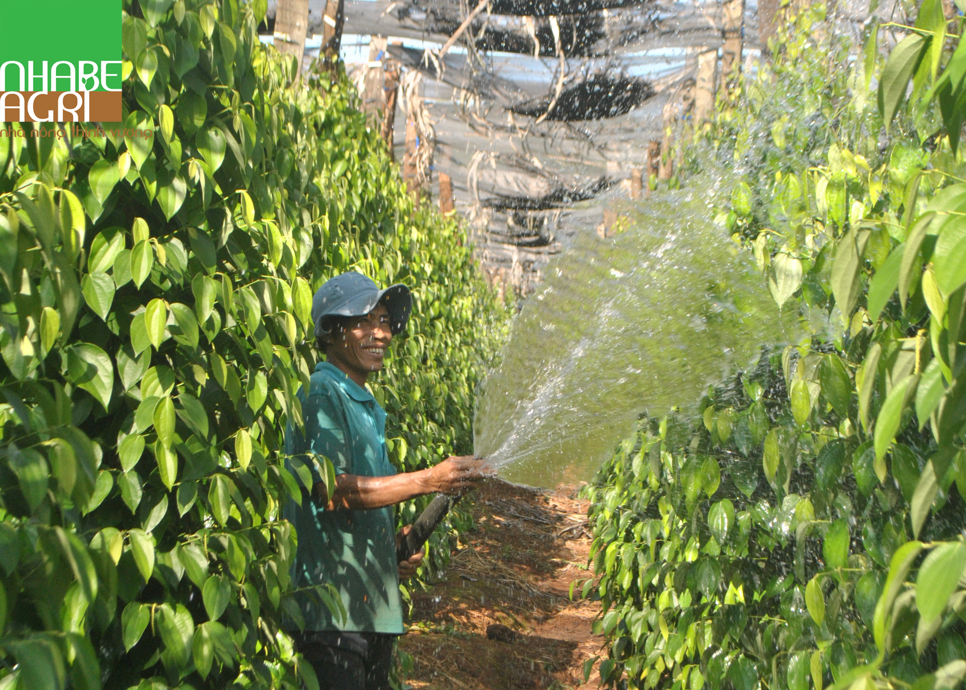

CORE IDEAS
Create a remote watering system
Labor support
IOT Application

Slide 6
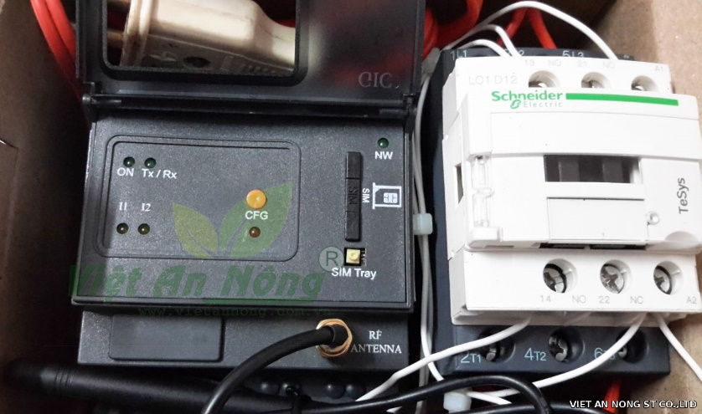
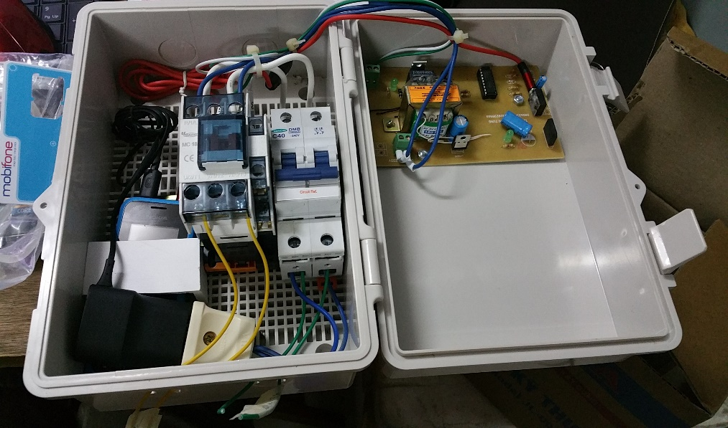
EXISTING COMPETITORS
Schneider Sprinkler Timer and Controller
HT-01 Mobile phone Controller

Slide 7



ADVANTAGES
Low cost
Using and manage
Extend scope
High Stability
Smart

Slide 8
WHY ANDROID MOBILE?
Team’s members have strong background in android
Do not have any devices to develop application by iOS or Window phone
We use some API from Google ( Google map, Google authentication ) and android support it better than others
Open source OS
Save cost for build app
The Popular and Price range of devices are larger than others
Support GSM

Slide 9

II. PROJECT MANAGEMENT
a look at our presentation agenda!

Slide 10
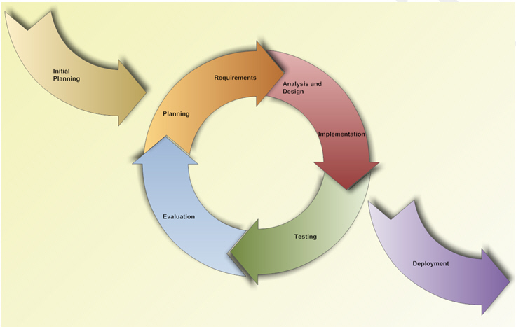
01
SOFTWARE PROJECT
LIFE CYCLE
Interactive and Incremental Model

Slide 11
02
PROJECT ORGANIZATION
Project Leader
Pham Quang Khang
Main Supervisor
PhD. Phan Duy Hung
Technical Leader
Le Anh Tuyen
Test Leader
Ho Quang Hao
Dev Team
QA Team
Pham Quang Khang
Bui Manh Tri
Nguyen Thi Ly Linh
Nguyen Thi Ly Linh
Lam Duc Thang
Ho Quang Hao
Le Anh
Tuyen

Slide 12
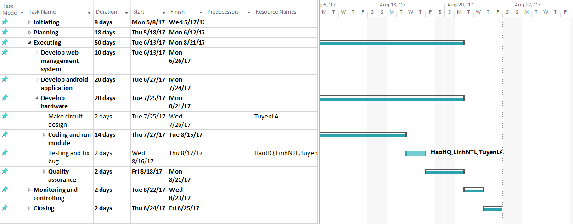
03
TASK PLAN

Slide 13









04
EQUIPMENT & TOOLS
Github
Smart GIT
Balsamiq Mockup
Fritzing
Astah
MS Office
MS Project
Window 10
mLab
Heroku

Slide 14







04
EQUIPMENT & TOOLS
Robo Mongo
Google Chrome
Web Storm
Android Studio
Arduino IDE
Google Drive
Postman

Slide 15
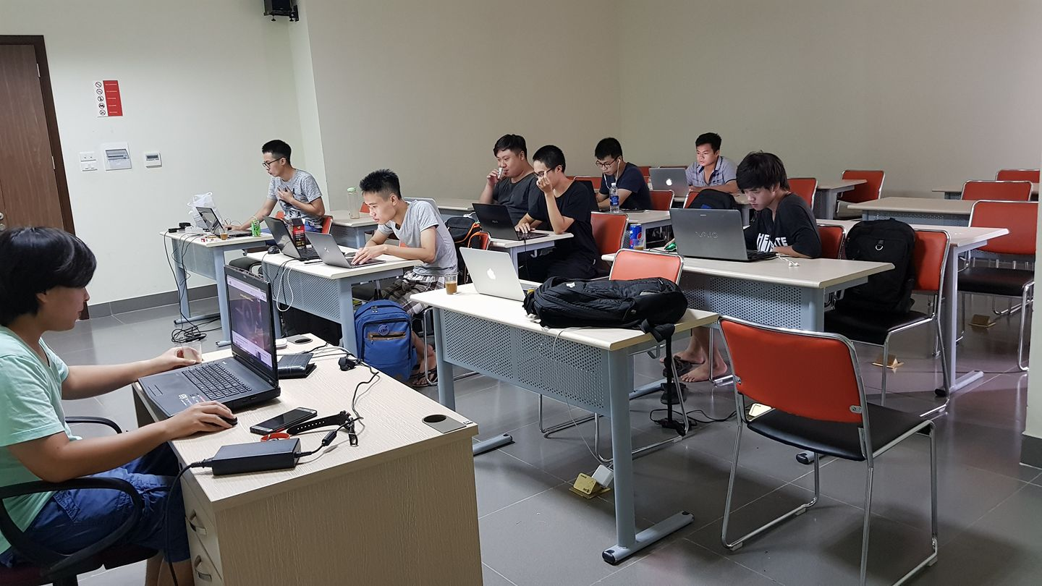


05
COMMUNICATION MANAGEMENT
Time: 3 hours / day, 5 days / week
Location: FPT University Hoa Lac
Communication:
Supervisor meeting: Once a week
Teambuilding: Once a week

Slide 16
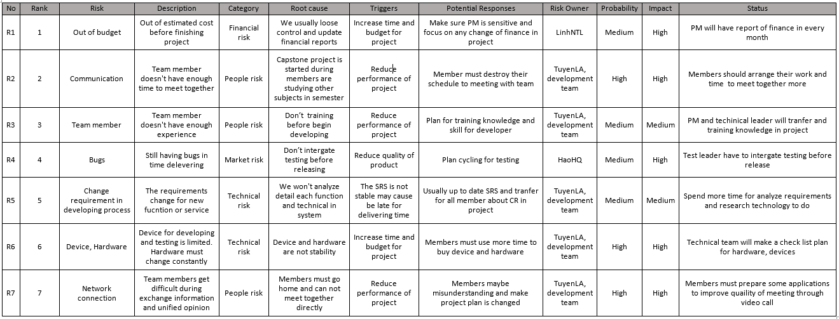
06
RISK MANAGEMENT

Slide 17


III. REQUIREMENTS
SPECIFICATION
Functional Requirement
Non - Functional Requirement

Slide 18
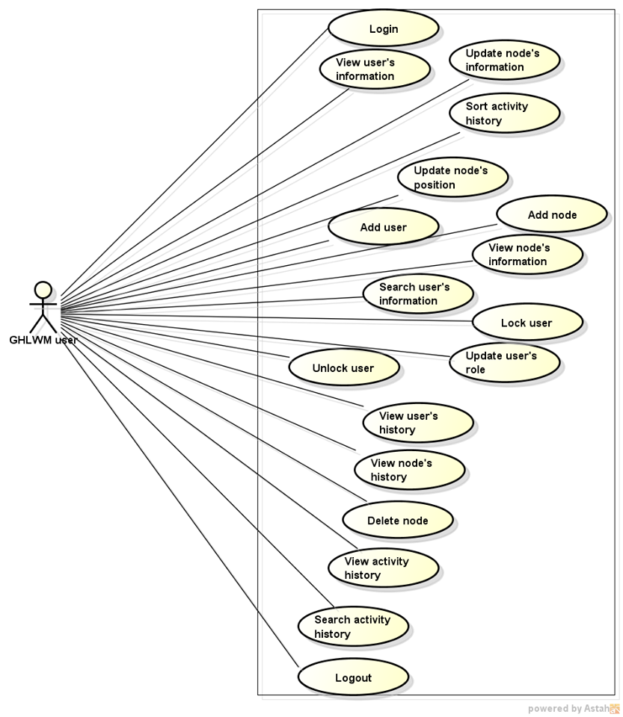
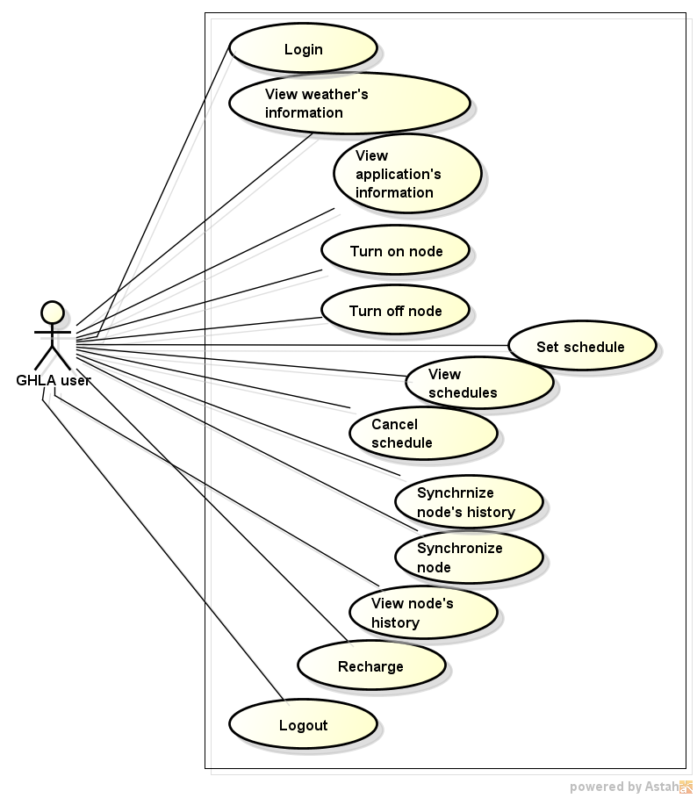
FUNCTIONAL REQUIREMENT

Slide 19



NON - FUNCTIONAL REQUIREMENT
Security
Availability
Usability

Slide 20
IV. SYSTEMS DESIGN
1
Architecture Overview
3
Mechanical Design
Software Design
Firmware Design
2
4

Slide 21
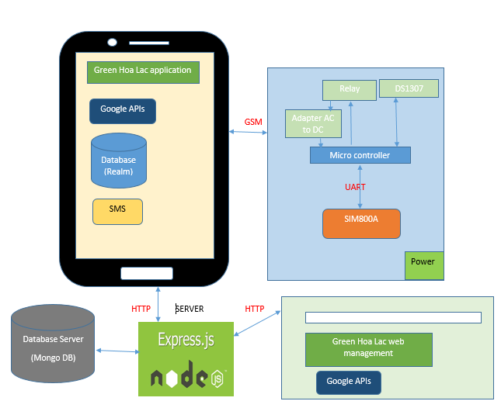
1
Architecture Overview

Slide 22


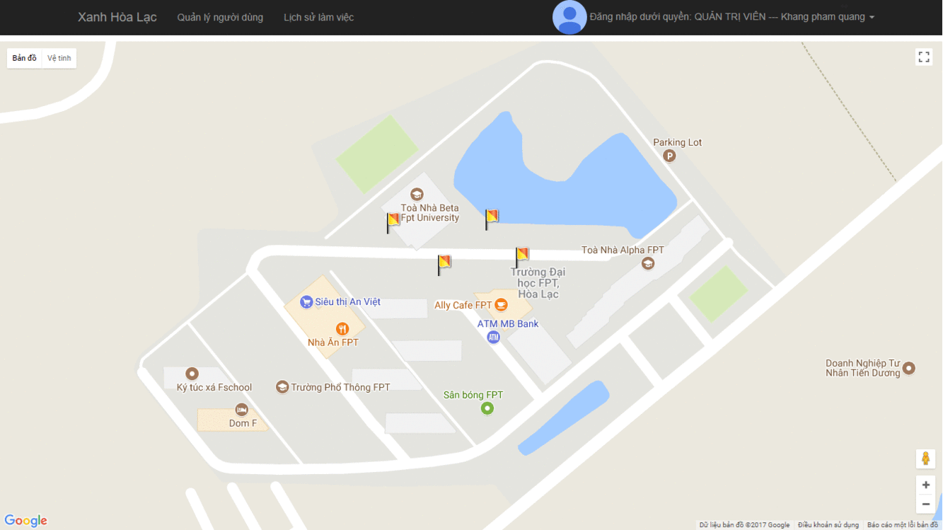
Software Design
Web Design
2
http://capstoneweb.herokuapp.com
Feature - 01
Feature - 02
Nodes Management
Users Management
Feature - 03
Feature - 04
Logs Management
Back-end RESTful api
The header of system where we manage the system, giving access role and following all of the actions from system

Slide 23










Software
Design
Web Design
2
http://capstoneweb.herokuapp.com
Server
Google APIs
HTTP
HTTP
HTTP
REST APIs
Client
Web APIs
HTTP
Android APIs

Slide 24

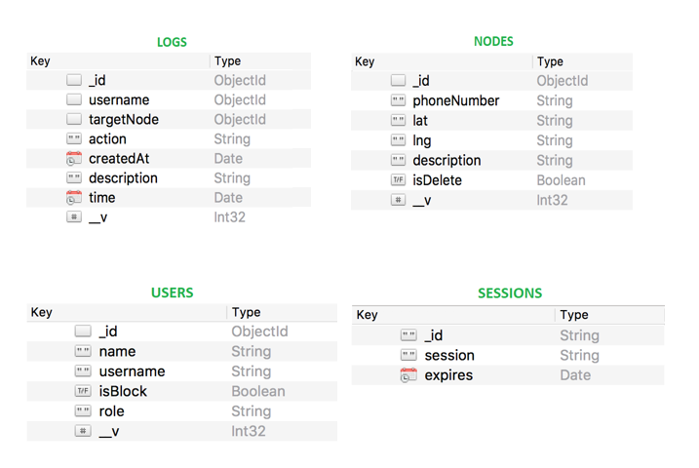
Software
Design
Web Design
2
http://capstoneweb.herokuapp.com
LOGS.username = USERS._id
LOGS.targetNode = NODES._id

Slide 25


Software
Design
Android App Design
2
REST APIs
Google APIs
Web APIs
Android APIs
HTTP
HTTP

Slide 26
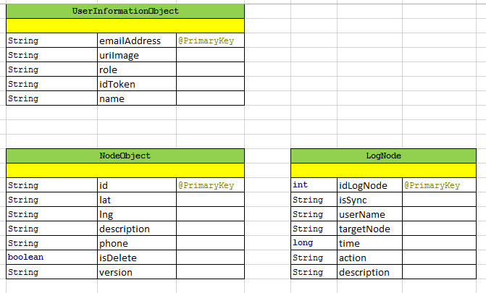
Software
Design
Android App Design
2

Slide 27
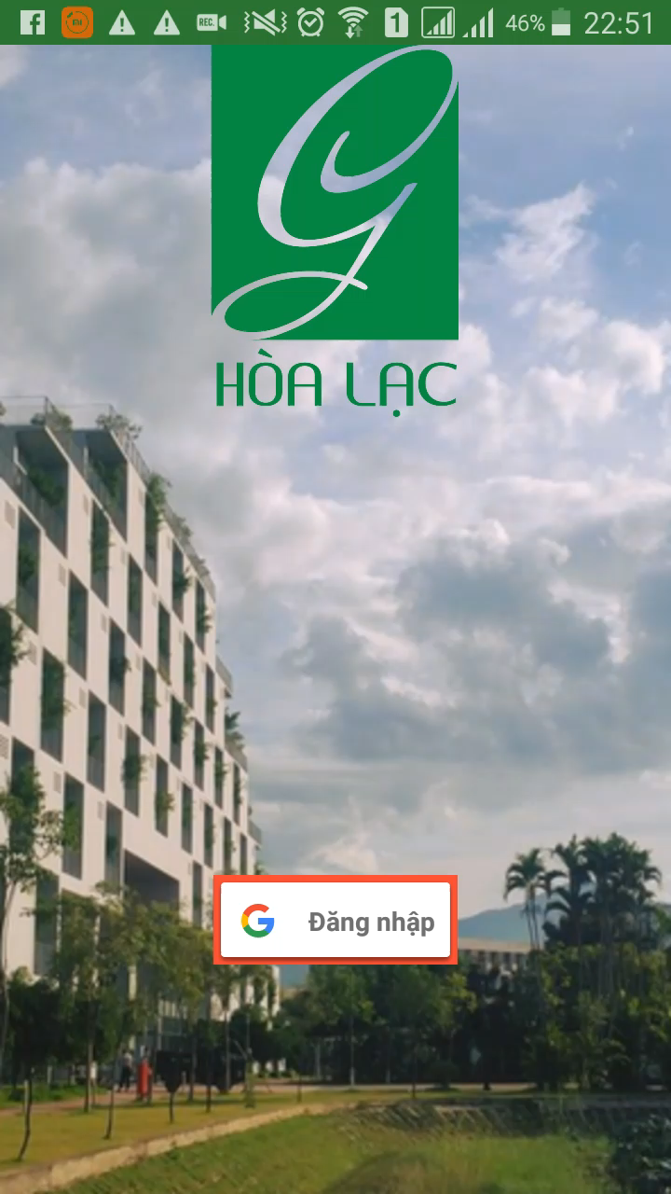

Software
Design
Android App Design
2
LOGIN

Slide 28
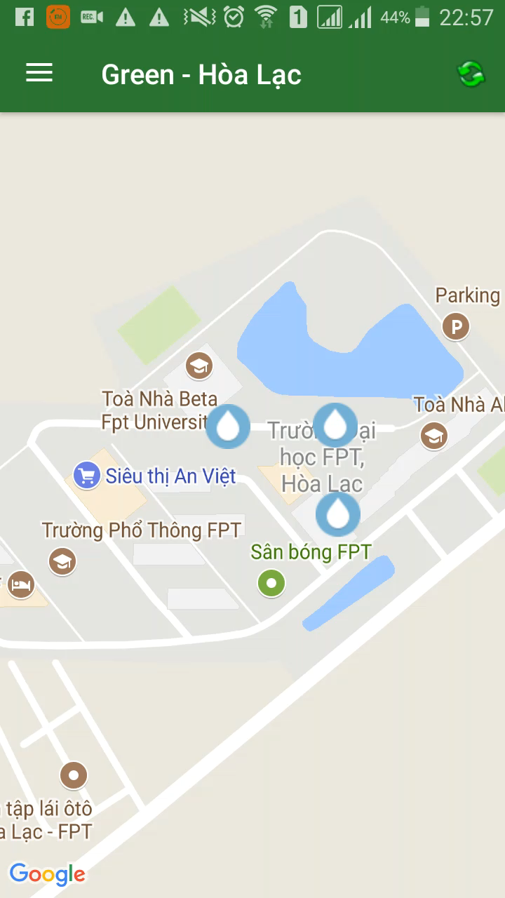
Software
Design
Android App Design
2
WEATHER FORECAST

Slide 29

Software
Design
Android App Design
2
SYNCHRONIZE NODE

Slide 30
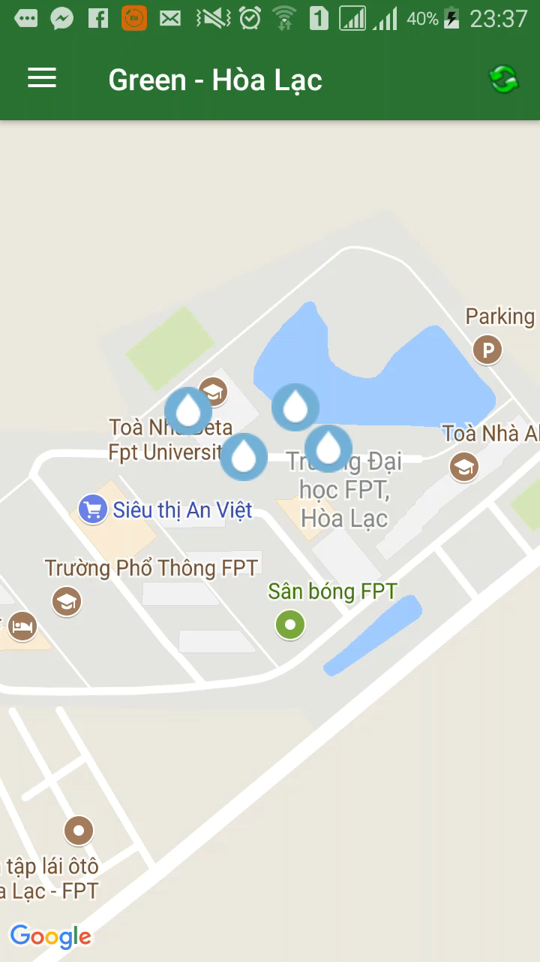
Software
Design
Android App Design
2
NODE SETTING

Slide 31
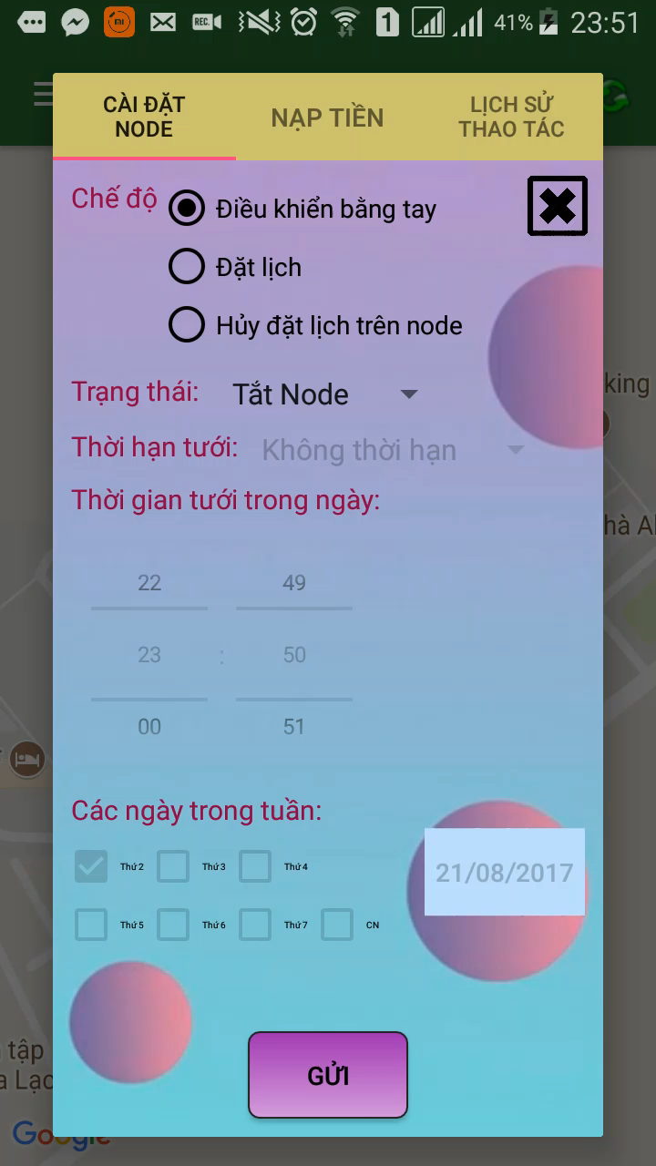
Software
Design
Android App Design
2
HISTORY OF ACTION

Slide 32
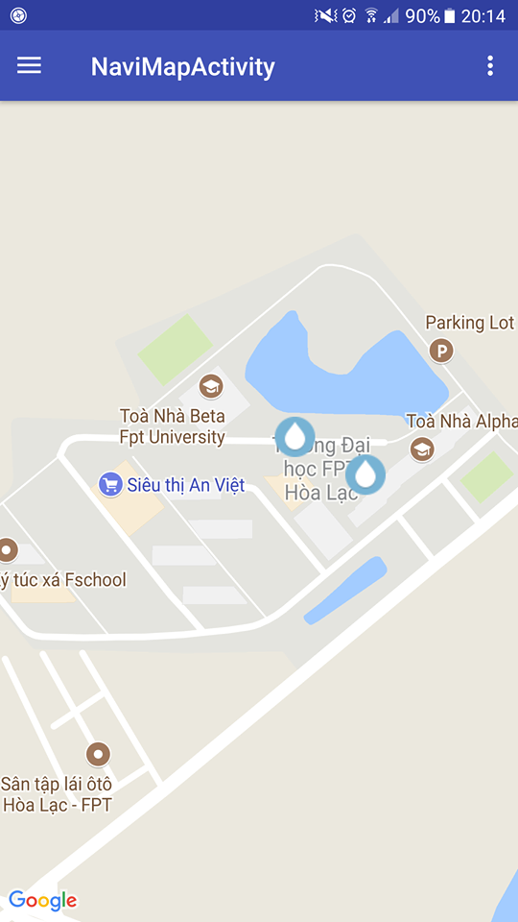


Software
Design
Android App Design
2
OFFLINE-MODE
Auto sing-in without checking from web server.
Auto load google map api state .
Auto load information from Realm Database.

Slide 33
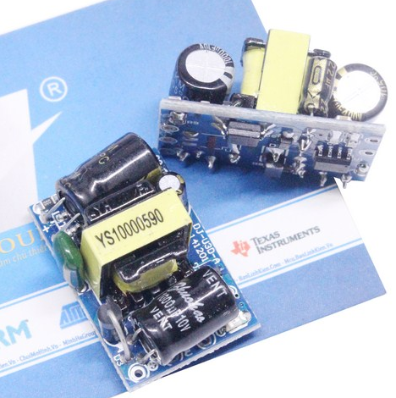
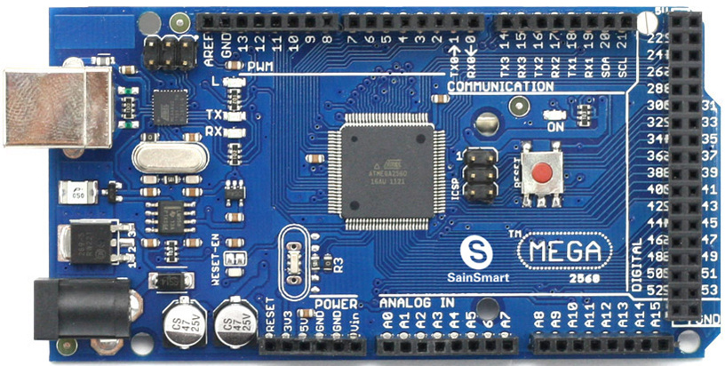
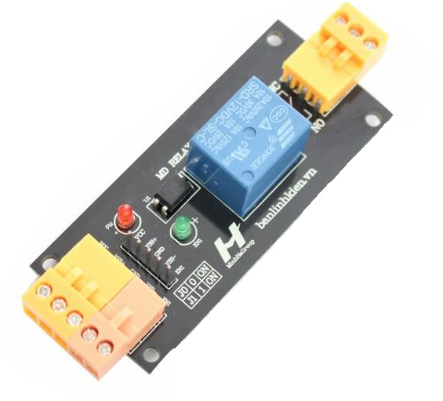
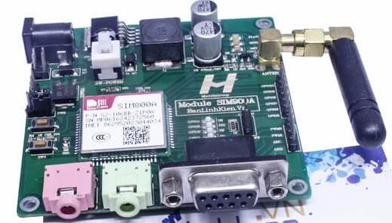
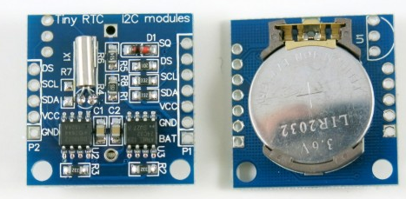
3
Mechanical Design
List of Hardware
Adapter AC to DC
Arduino mega 2560
Relay
Sim 800a Mh
RTC DS1307

Slide 34
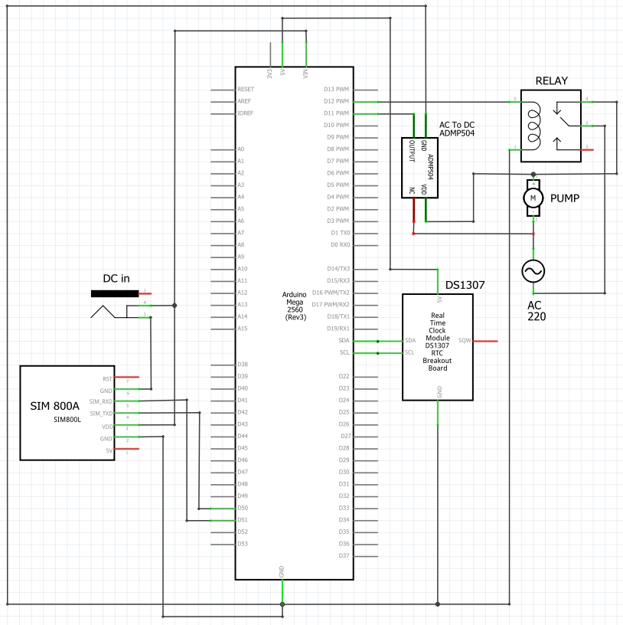
3
Mechanical Design

Slide 35
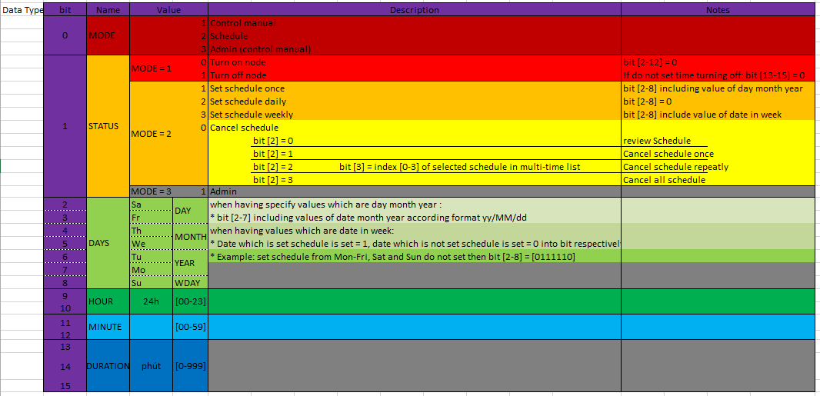
Firmware Design
4

Slide 36
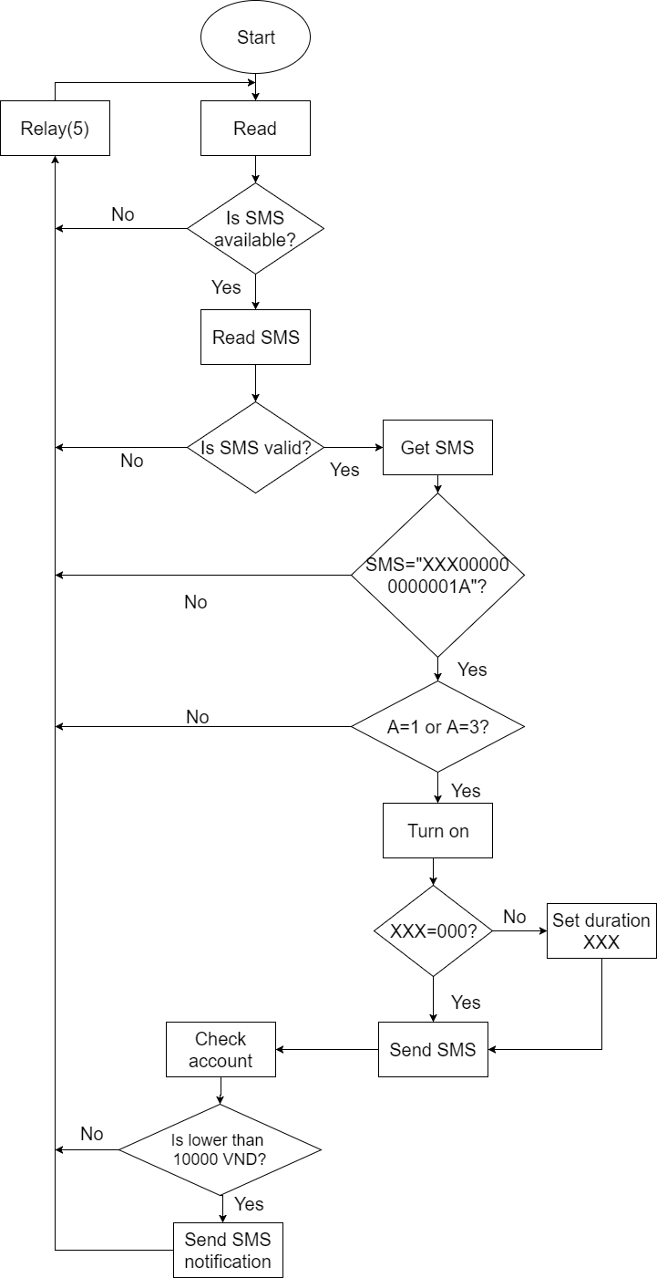
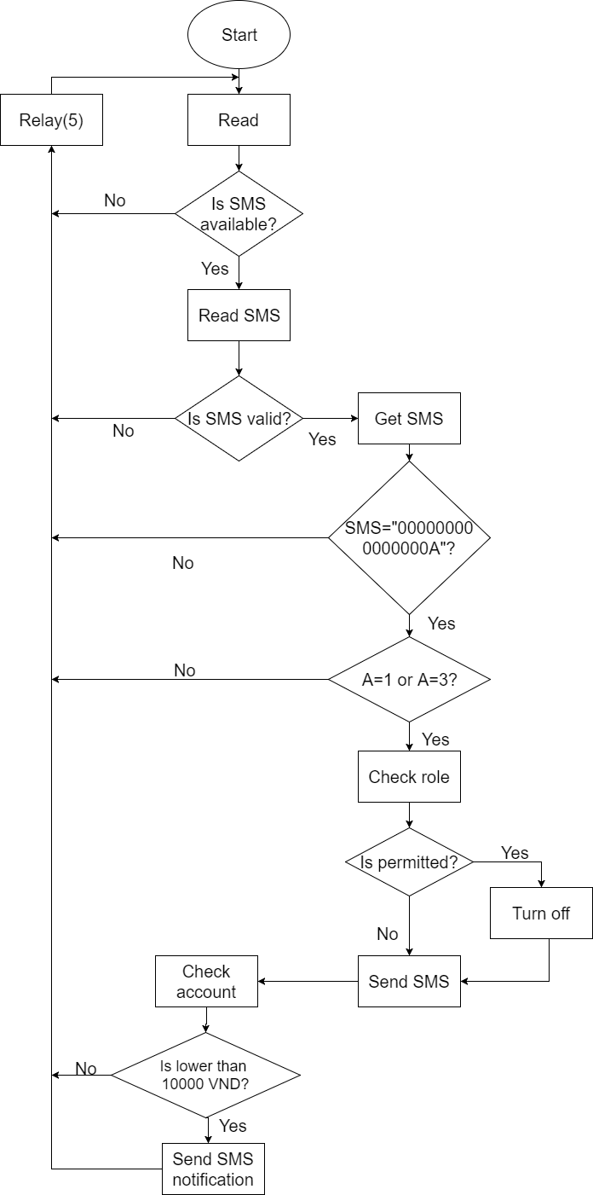
Firmware Design
Get ON
Get OFF
4

Slide 37
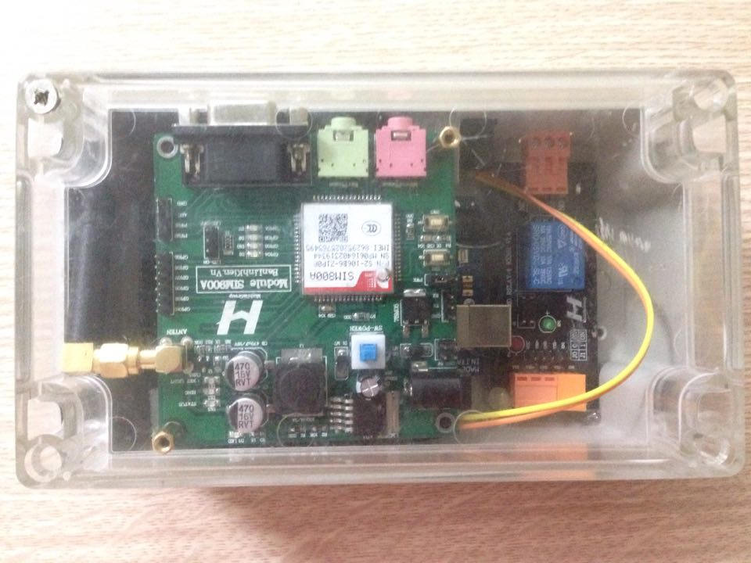
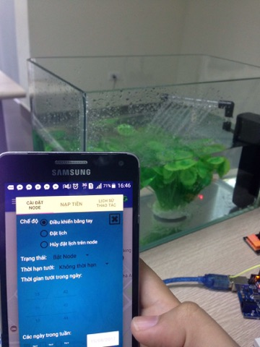
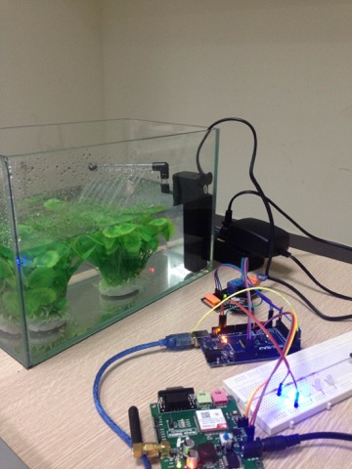
V. IMPLEMENT

Slide 38
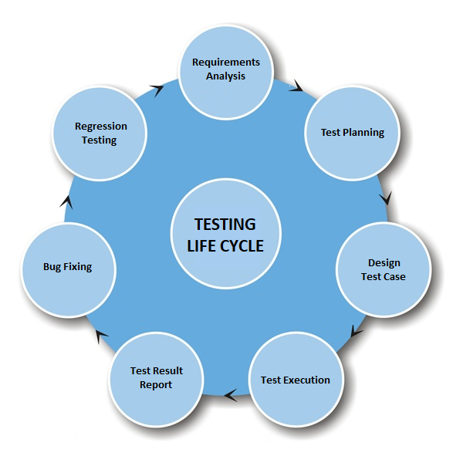
VI.
Testing

Slide 39
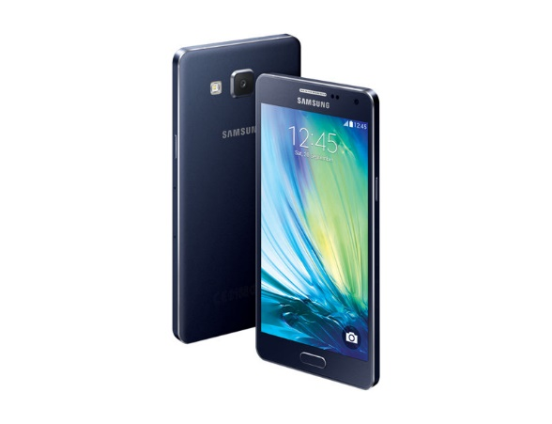




01
TESTING TOOL

Slide 40
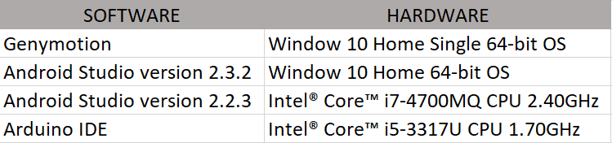
TEST ENVIRONMENT
02

Slide 41
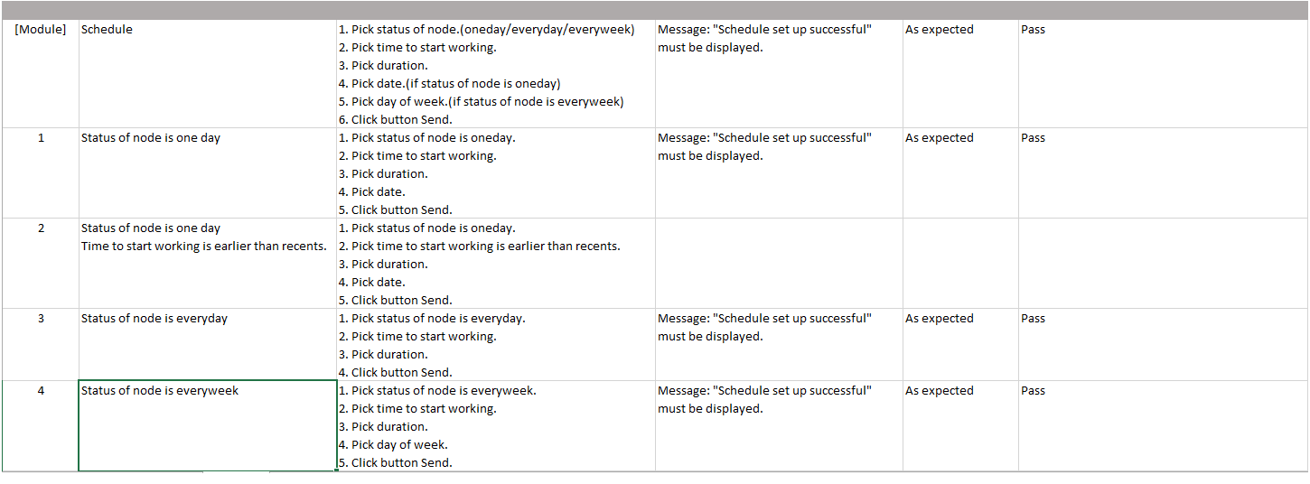
03
TEST CASE

Slide 42
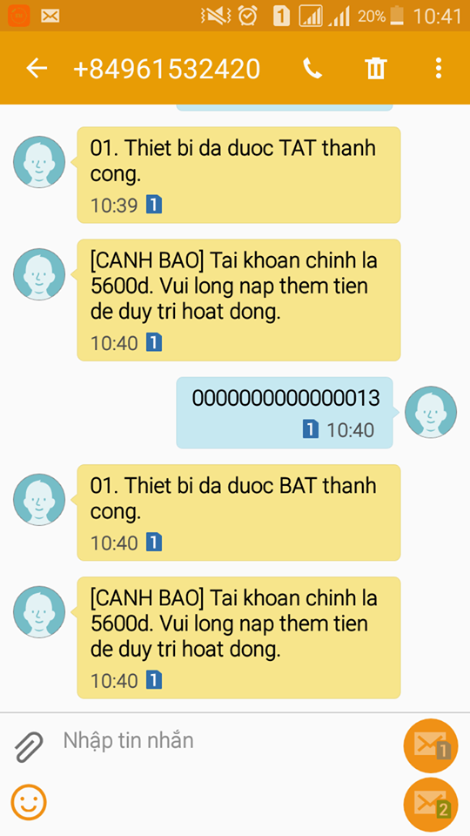
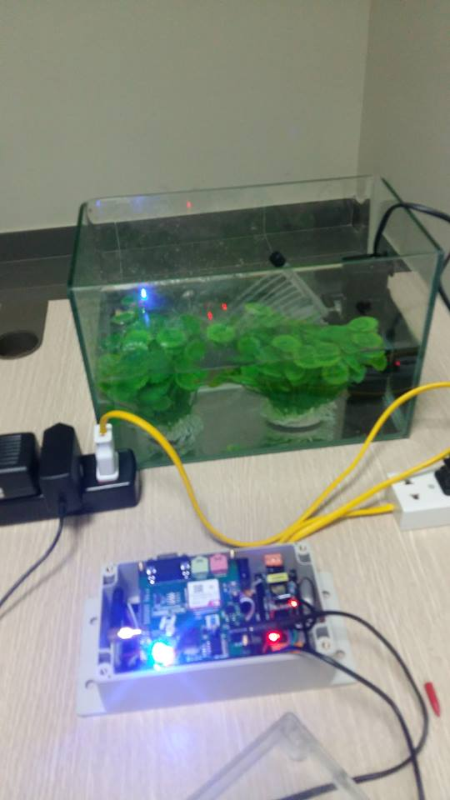
04
TEST EVIDENCE

Slide 43
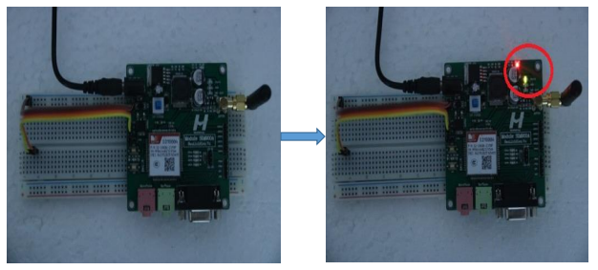
04
TEST EVIDENCE

Slide 44
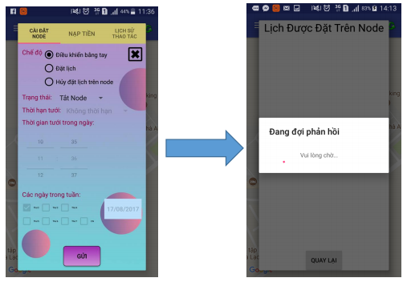
04
TEST EVIDENCE

Slide 45
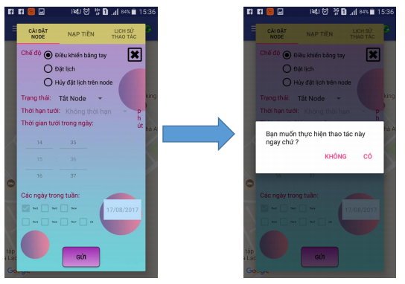
04
TEST EVIDENCE

Slide 46
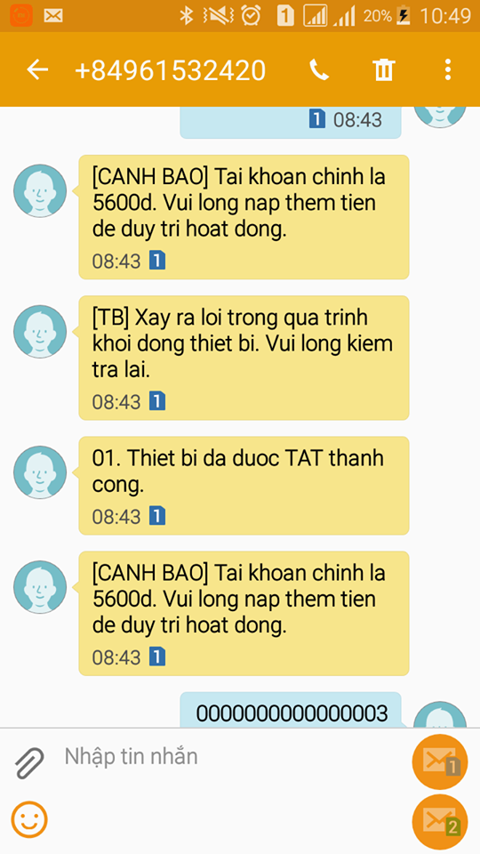
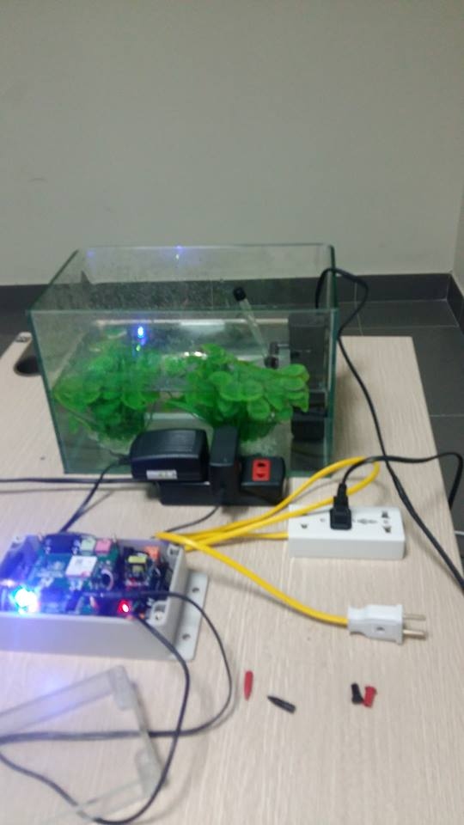
04
TEST EVIDENCE

Slide 47
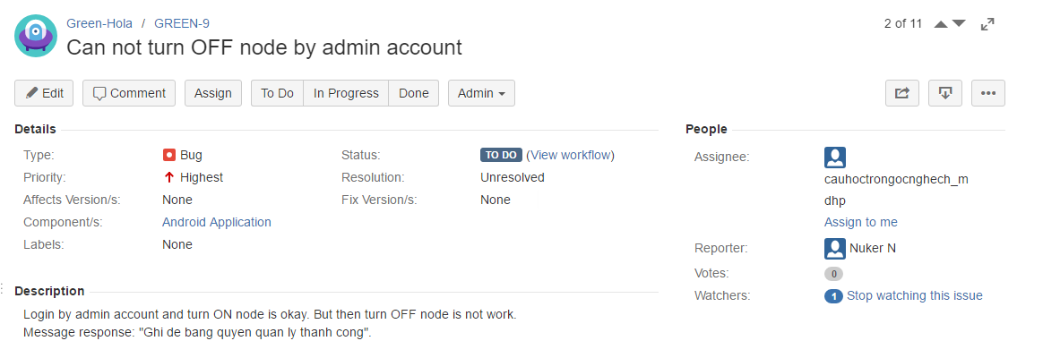
BUG LOGGING PROCESS
05

Slide 48




VII. Lesson Learned
Teamwork
Business Analysis
Management Skill
New Knowledge

Slide 49

VIII. DEMO Q&A

Slide 50
Thanks for watching!

